Slide 1
ILC Design Overview
Nick Walker (DESY/GDE)
GDE Internal Cost Review FNAL 13.11.12

Slide 2
Contents
Requirements (from Physics and Detector)
Design evolution to the TDR baseline
Baseline 500 GeV E_{cm} Parameters
Approach to Site-Dependent Design Variants
ILC overview (intro to detail talks)
RTML and bunch compressor
Emittance preservation (beam dynamics)
Low E_{cm} Running
Luminosity upgrade
TeV energy upgrade

Slide 3
Requirements from ‘the customers’
http://ilc-edmsdirect.desy.de/ilc-edmsdirect/document.jsp?edmsid=*948205
Baseline:
Energy range: 200 ≤ E_{cm} ≤ 500 GeV
∫Ldt ~ 500 fb⁻¹ (in four years)
Ability to make energy scans (about Ecm)
ΔE/E ≤ 0.1%
both pulse ‘jitter’ and bunch/train energy spread
Electron polarisation ≥ 80%
Support for two detectors
push-pull
Calibration at Z-pole (~90 GeV)
but low lumi.
Beamstrahlung ‘low’ (~few %)
Upgrades:
Energy upgrade to ~ 1 TeV ← important
Not to exclude e⁻e⁻ or γγ collider options
Polarised positrons ≥50%
Giga-Z (Z factory with several 10³³ cm⁻²s⁻¹)
focus of GDE design efforts
conceptual approach considered.
acknowledged but not considered in any detail

Slide 4
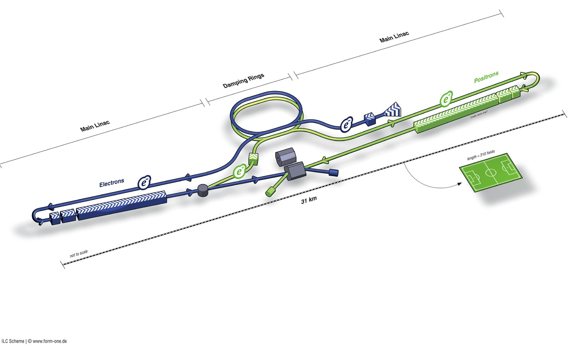
ILC in a Nutshell
Polarised electron source
Damping Rings
Ring to Main Linac (RTML)
(inc. bunch compressors)
e+ Main Linac
Beam Delivery System (BDS) & physics detectors
Polarised positron source
Beam dump
e- Main Linac
not too scale

Slide 5
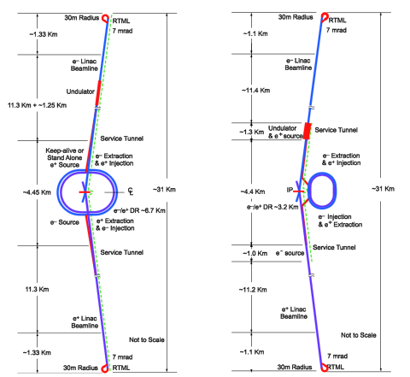
Design Evolution: RDR→TDR
2007 Reference Design Report and cost estimate
2008-2012 Technical Design Phase
Re-evaluation of baseline layout → updated design
Updated value estimate
RDR
SB2009

Slide 6
Scope of Design Changes
31.5 MV/m average accelerating gradient including ±20% spread
Single tunnel for Main Linacs
Undulator-based e⁺ source relocation to end of e⁻ Main Linac
RDR: located at nominal 150 GeV point in elec. main linac
Reduced beam-power parameter set
2625 → 1312 bunches per pulse (8.8 → 5.8mA)
reduced klystron / modulator count (~30%)
and…
6.4→3.2km circumference Damping Ring
Central region integration (general)
RTML, sources and BDS integration

Slide 7
ILC Published Parameters
Luminosity Upgrade
Centre-of-mass independent:
Collision rate | Hz | 5
Number of bunches |  | 1312 | 2625
Bunch population | ×10¹⁰ | 2
Bunch separation | ns | 554 | 366
Pulse current | mA | 5.8 | 8.8
Beam pulse length | μs | 730 | 960
RMS bunch length | mm | 0.3
Horizontal emittance | μm | 10
Vertical emittance | nm | 35
Electron polarisation | % | 80
Positron polarisation | % | 30
Advantage of SCRF technology: long pulses
http://ilc-edmsdirect.desy.de/ilc-edmsdirect/item.jsp?edmsid=D00000000925325

Slide 8
ILC Published Parameters
Centre-of-mass dependent:
Centre-of-mass energy | GeV | 200 | 230 | 250 | 350 | 500
Electron RMS energy spread | % | 0.21 | 0.19 | 0.19 | 0.16 | 0.12
Positron RMS energy spread | % | 0.19 | 0.16 | 0.15 | 0.10 | 0.07
IP horizontal beta function | mm | 16 | 16 | 12 | 15 | 11
IP vertical beta function | mm | 0.48 | 0.48 | 0.48 | 0.48 | 0.48
IP RMS horizontal beam size | nm | 904 | 843 | 700 | 662 | 474
IP RMS veritcal beam size | nm | 9.3 | 8.6 | 8.3 | 7.0 | 5.9
Vertical disruption parameter |  | 20.4 | 20.4 | 23.5 | 21.1 | 24.6
Enhancement factor |  | 1.83 | 1.83 | 1.91 | 1.84 | 1.95
Geometric luminosity | ×10³⁴ cm⁻²s⁻¹ | 0.25 | 0.29 | 0.36 | 0.45 | 0.75
Luminosity | ×10³⁴ cm⁻²s⁻¹ | 0.50 | 0.59 | 0.75 | 0.93 | 1.8
% luminosity in top 1% ΔE/E |  | 92% | 90% | 84% | 79% | 63%
Average energy loss |  | 1% | 1% | 1% | 2% | 4%
Pairs / BX | ×10³ | 41 | 50 | 70 | 89 | 139
Total pair energy / BX | TeV | 24 | 34 | 51 | 108 | 344
http://ilc-edmsdirect.desy.de/ilc-edmsdirect/item.jsp?edmsid=D00000000925325
Notes:
General observations:
Factor of 2 in L from enhancement – relatively large disruption parameter -> tight tolerances on collisions to IP (feedback)

Slide 9
ILC Published Parameters
Centre-of-mass dependent:
Focus of design (and cost!) effort
Centre-of-mass energy | GeV | 200 | 230 | 250 | 350 | 500
Electron RMS energy spread | % | 0.21 | 0.19 | 0.19 | 0.16 | 0.12
Positron RMS energy spread | % | 0.19 | 0.16 | 0.15 | 0.10 | 0.07
IP horizontal beta function | mm | 16 | 16 | 12 | 15 | 11
IP vertical beta function | mm | 0.48 | 0.48 | 0.48 | 0.48 | 0.48
IP RMS horizontal beam size | nm | 904 | 843 | 700 | 662 | 474
IP RMS veritcal beam size | nm | 9.3 | 8.6 | 8.3 | 7.0 | 5.9
Vertical disruption parameter |  | 20.4 | 20.4 | 23.5 | 21.1 | 24.6
Enhancement factor |  | 1.83 | 1.83 | 1.91 | 1.84 | 1.95
Geometric luminosity | ×10³⁴ cm⁻²s⁻¹ | 0.25 | 0.29 | 0.36 | 0.45 | 0.75
Luminosity | ×10³⁴ cm⁻²s⁻¹ | 0.50 | 0.59 | 0.75 | 0.93 | 1.8
% luminosity in top 1% ΔE/E |  | 92% | 90% | 84% | 79% | 63%
Average energy loss |  | 1% | 1% | 1% | 2% | 4%
Pairs / BX | ×10³ | 41 | 50 | 70 | 89 | 139
Total pair energy / BX | TeV | 24 | 34 | 51 | 108 | 344
http://ilc-edmsdirect.desy.de/ilc-edmsdirect/item.jsp?edmsid=D00000000925325

Slide 10
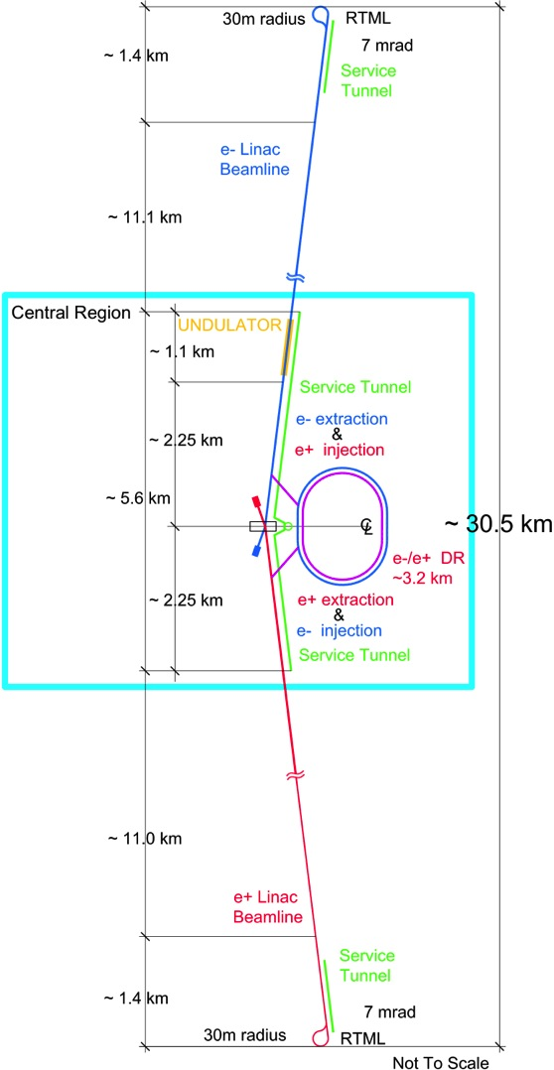
ILC Footprint
Total site length (500 GeV CM) | 30.5 km
SCRF Main Linacs | 22.2 km
RTML (bunch compressors) | 2.8 km
Positron source | 1.1 km
BDS / IR | 4.5 km
Damping Rings (circumference) | 3.2 km
There are the SCRF main linacs….
… and there is everything else.

Slide 11
Site-Dependent Designs
Top-level parameters
Accelerator layout
lattice
geometry
parameters
etc.
CFS requirements
Central region (source, BDS, DR)
RTML (bunch compressors)
Civil engineering solutions
topography
geology
Main linac layout
RF power distribution (→ CFS)
cost effective tunnelling methods

Slide 12
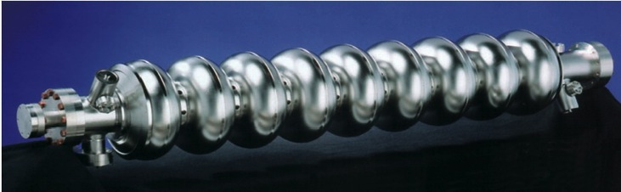
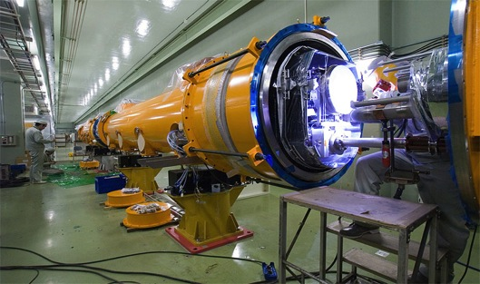
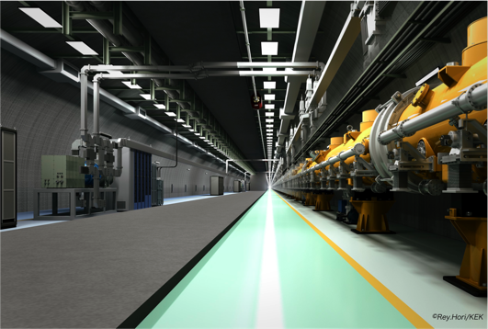
SCRF Linac Technology
1.3 GHz Nb 9-cellCavities | 16,024
Cryomodules | 1,855
SC quadrupole pkg | 673
10 MW MB Klystrons & modulators | 436 / 471 *
* site dependent
Approximately 20 years of R&D worldwide
→ Mature technology
→ Presentation by A. Yamamoto

Slide 13
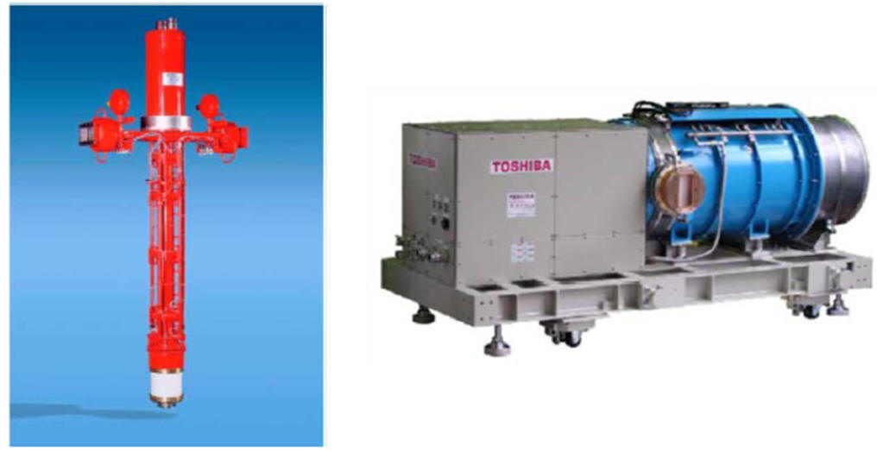
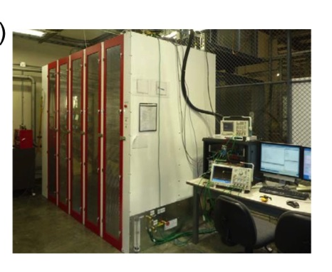
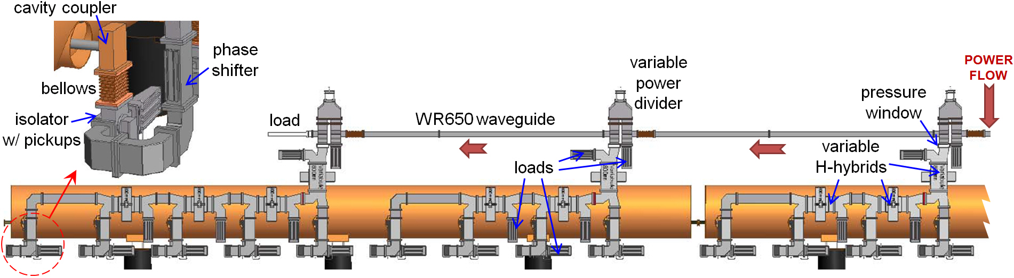
RF Power Source
Marx modulator
10MW MB Klystron
Adjustable local power distribution system
→ Presentation by S. Fukuda

Slide 14
Main Linac Parameters (500 GeV)
Average accelerating gradient | 31.5 (±20%) | MV/m
Cavity Q₀ | 10¹⁰
(Cavity qualification gradient | 35 (±20%) | MV/m)
Beam current | 5.8 | mA
Number of bunches per pulse | 1312
Charge per bunch | 3.2 | nC
Bunch spacing | 554 | ns
Beam pulse length | 730 | μs
RF pulse length (incl. fill time) | 1.65 | ms
Efficiency (RF→beam) | 0.44
Pulse repetition rate | 5 | Hz
Peak beam power per cavity | 190* | kW
* at 31.5 MV/m

Slide 15
Site Dependence I: KCS
Klystron Cluster
Scheme
Novel system
35×10 MW MBK → 350 MW
Feeds ~1 km of linac via over-moded circular WG (∅ 48 cm)
~8 MW ‘tapped-off’ every 26 cavities
Special Coxaxial Tap-Offs (CTO) used for both combining and splitting

Slide 16
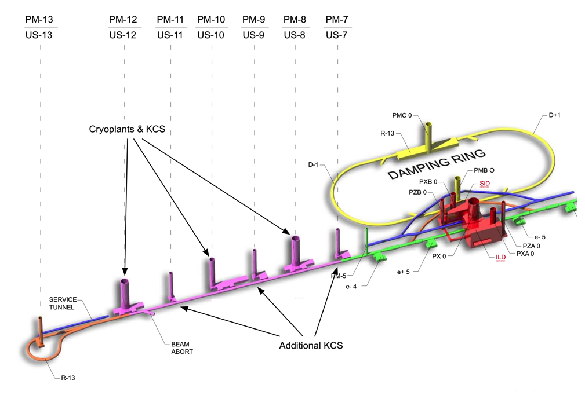
Site Dependence I: KCS
“Flat” topography site-dependent design
→ Presentations by M. Ross and V. Kuchler

Slide 17
Site Dependence II: DKS
“Komoboko” tunnel
Reduced surface presence.
Horizontal access
Most infrastructure underground.
“Mountainous” Topography site-dependent design
→ Presentation by A. Enomoto

Slide 18
Site Dependence II: DKS
Distributed
Klystron
Scheme
accelerator cryomodules
→ presentations by M. Ross and S. Fukuda

Slide 19
ILC in a Nutshell
Polarised electron source
Damping Rings
Ring to Main Linac (RTML)
(inc. bunch compressors)
e+ Main Linac
Beam Delivery System (BDS) & physics detectors
Polarised positron source
Beam dump
e- Main Linac
not too scale

Slide 20
Ring To Main Linac (RTML)
5 GeV
(FoDo lattice)
5 GeV
5 GeV
15 GeV
15 GeV
5 GeV
R₅₆ = -372 mm
R₅₆ = -55 mm
÷6.7
÷3
bunch length: 6 mm
0.9 mm
0.3 mm
beam energy: 5 GeV
4.8 GeV
15 GeV
ΔE/E: 0.11%
1.42%
1.12%
DKS also used for flat topography site

Slide 21
RTML / Bunch Compressor
Emittance preservation primary challenge
fast ion instability in ~30km long return line
stray time-varying fields (≤2 nT).
spin rotation (solenoids → x-y coupling)
RF and long bunch / large ΔE/E
→ wakefields, coupler kicks, cavity tilt effects…
➔ beam based alignment
Tight requirements on phase/amplitude stability
timing at IP → luminosity loss
0.24° / 0.48° stability (correlated/uncorrelated)
LLRF challenge

Slide 22
Central Region
5.6 km region around IR
Systems:
electron source
positron source
beam delivery system
RTML (return line)
IR (detector hall)
damping rings
Complex and crowded area
Central Region
common tunnel

Slide 23
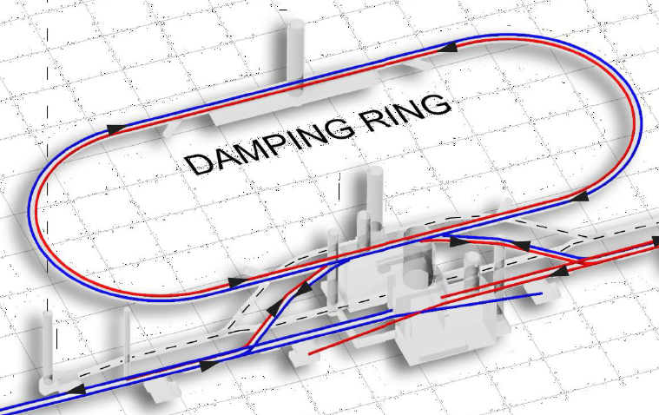
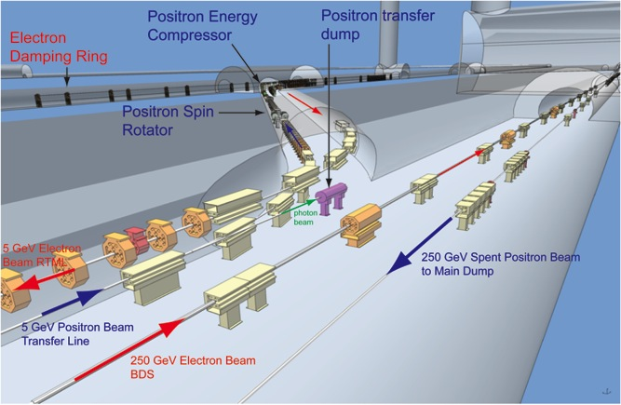
Central Region
Example: Flat Topography
The central region beam tunnel remains a complex region.
Complete, detailed and integrated lattices are now available
service tunnel
Generic design used for geometry and generating component counts and CFS requirements.
CFS (particularly CE) solutions are site-dependent!

Slide 24
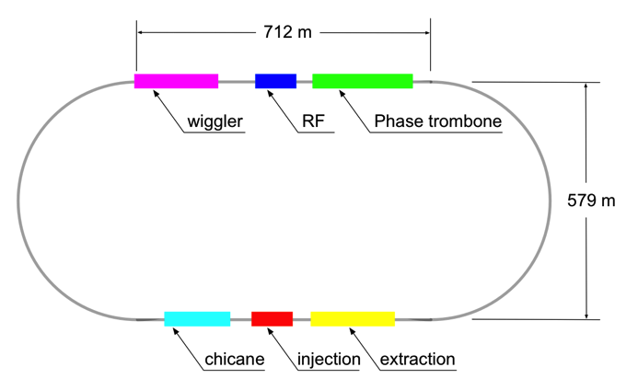
Damping Rings
Circumference |  | 3.2 | km
Energy |  | 5 | GeV
RF frequency |  | 650 | MHz
Beam current |  | 390 | mA
Store time |  | 200 (100) | ms
Trans. damping time |  | 24 (13) | ms
Extracted emittance | x | 5.5 | μm
(normalised) | y | 20 | nm
No. cavities |  | 10 (12)
Total voltage |  | 14 (22) | MV
RF power / coupler |  | 176 (272) | kW
No.wiggler magnets |  | 54
Total length wiggler |  | 113 | m
Wiggler field |  | 1.5 (2.2) | T
Beam power |  | 1.76 (2.38) | MW
Values in () are for 10-Hz mode
Many similarities to modern 3rd-generation light sources
→ presentation by G. Dugan

Slide 25
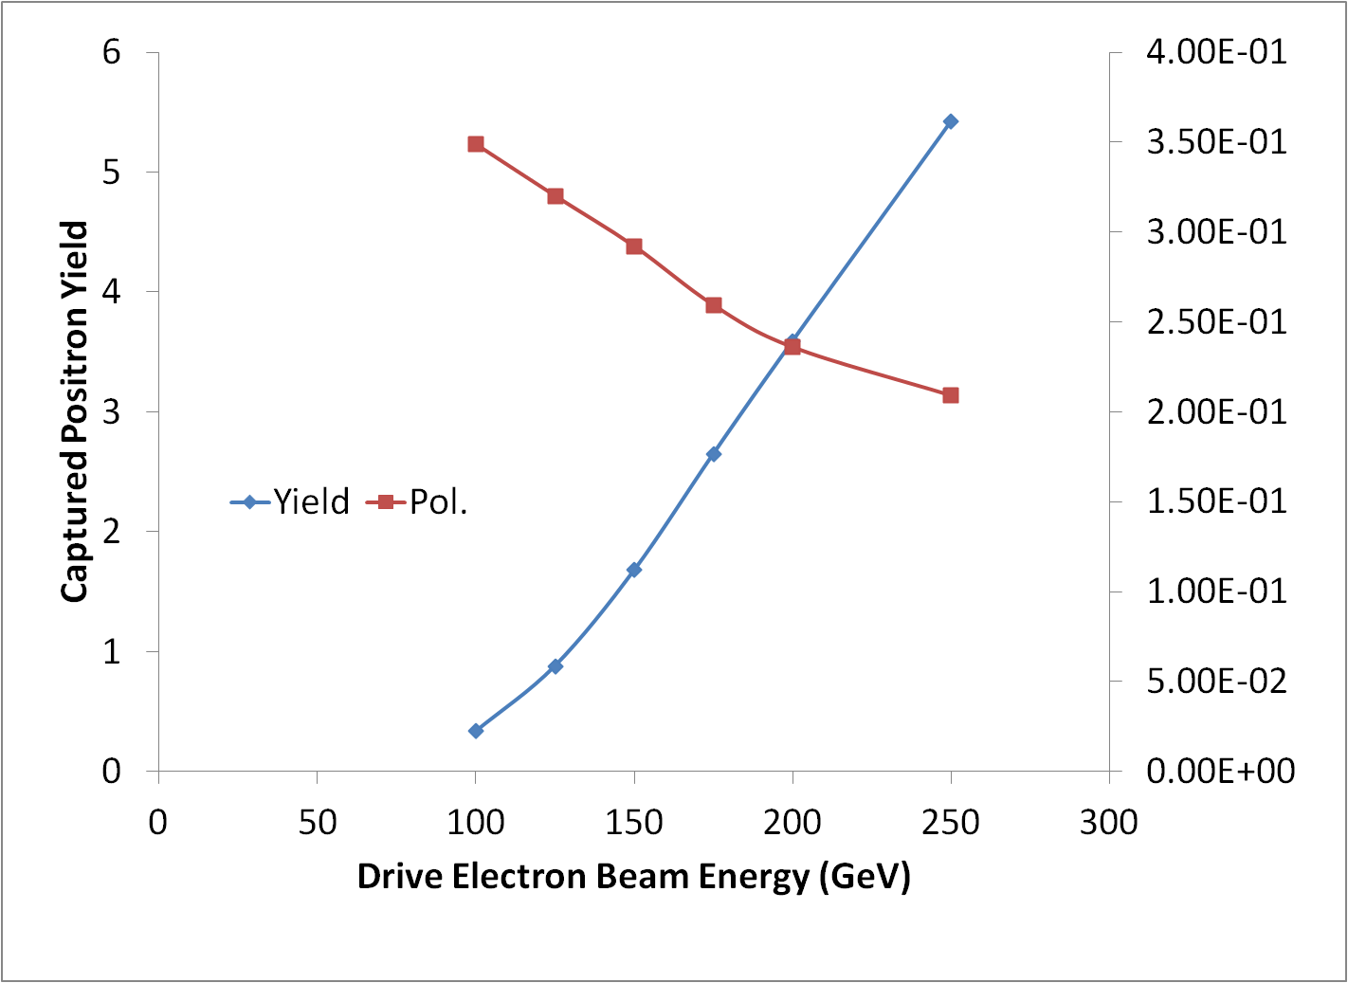
Positron Source (central region)
located at exit of electron Main Linac
147m SC helical undulator
driven by primary electron beam (150-250 GeV)
produces ~30 MeV photons
converted in thin target into e+e- pairs
yield = 1.5
not to scale!
→ Presentation by W. Gai

Slide 26
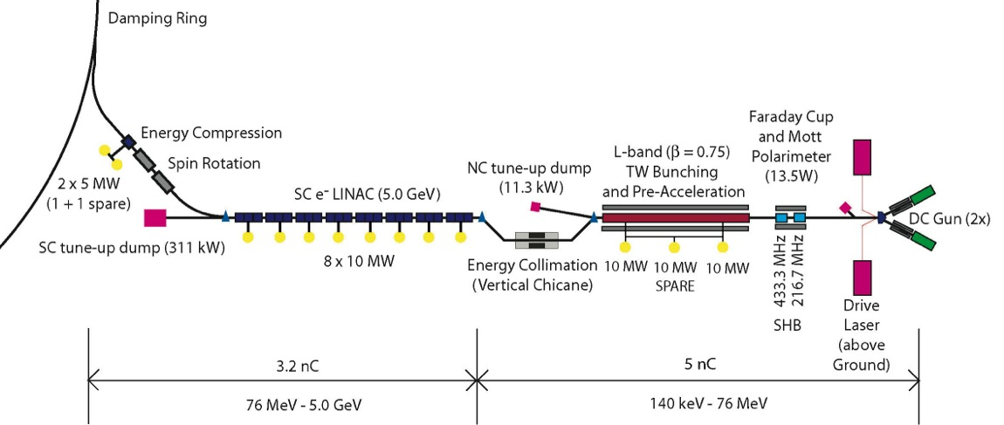
Polarised Electron Source
Laser-driven photo cathode (GaAs)
DC gun
Integrated into common tunnel with positron BDS
→ Presentation by W. Gai

Slide 27
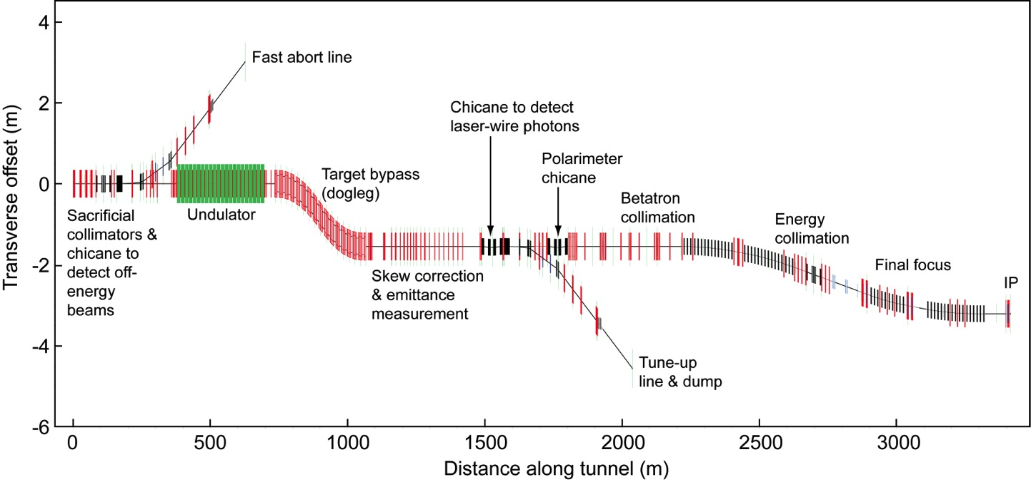
BDS and MDI
Geometry ready for TeV upgrade
e+ source
e- BDS
→ Presentation by K. Buesser
electron Beam Delivery System

Slide 28
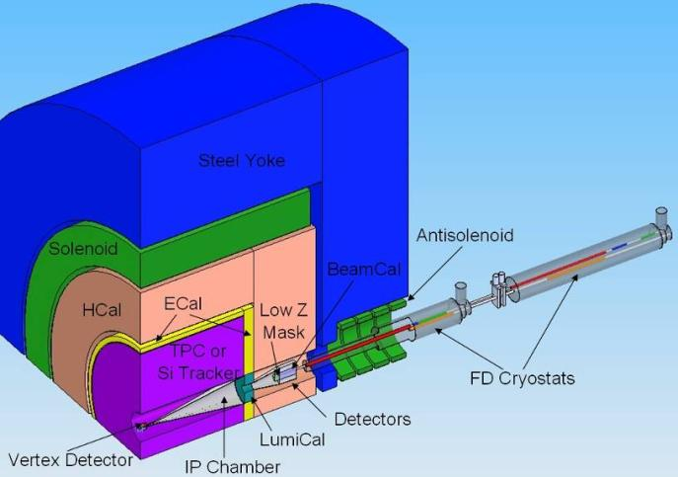
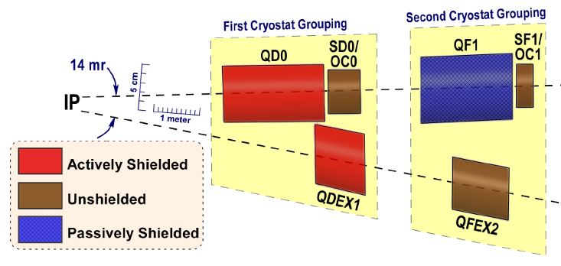
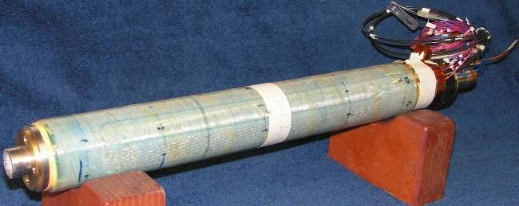
IR region (Final Doublet)
FD arrangement for push pull
different L*
ILD 4.5m, SiD 3.5m
Short FD for low E_{cm}
Reduced β_{x}*
increased collimation depth
“universal” FD
avoid the need to exchange FD
conceptual - requires study
Many integration issues remain
requires engineering studies beyond TDR
No apparent show stoppers
BNL prototype of self shielded quad
→ Presentation by K. Buesser
Notes:
Short FD effectively increases collimation depth (SR fan from FD). Universal FD (to prevent having to exchange cryostats) still requires proof of principle design.
Still many integration issues for IR/MDI. Requires engineering studies (beyond TDR).

Slide 29
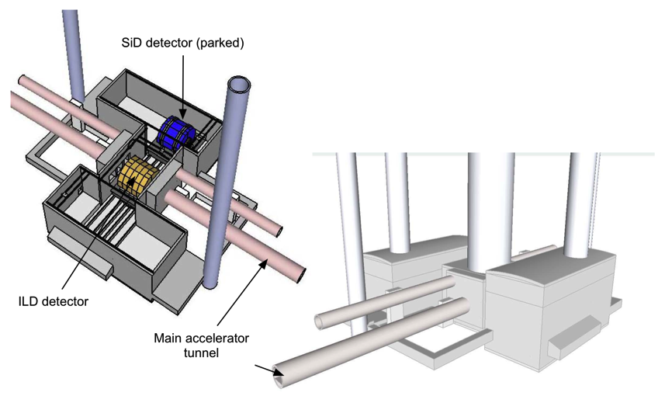
MDI (Detector Hall)
Flat-topography detector hall concept
→ Presentation by K. Buesser
Notes:
Should add mountain 3D graphic

Slide 30
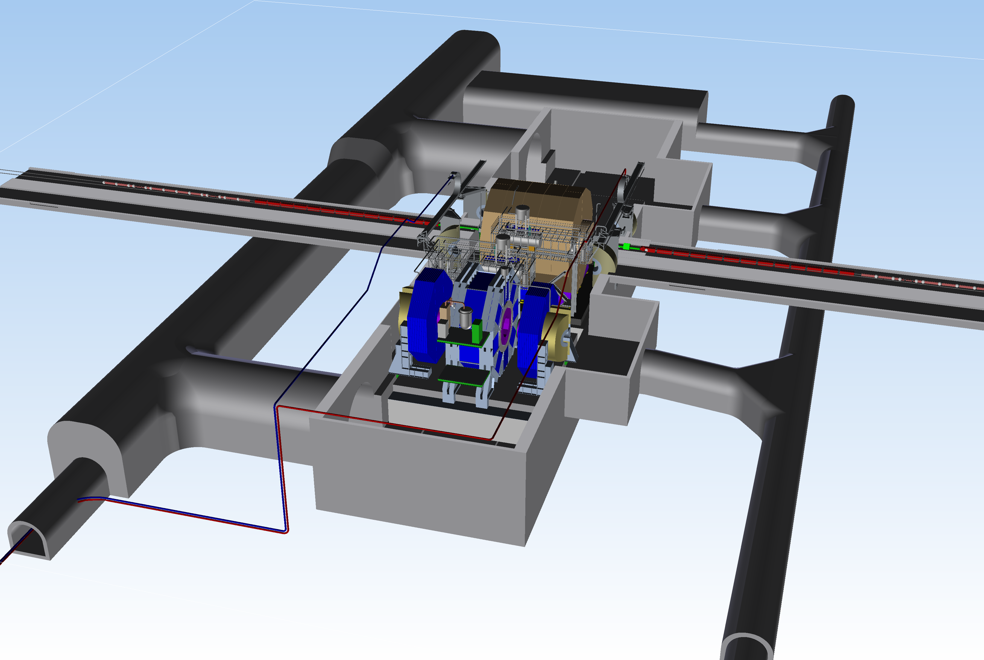
MDI (Detector Hall)
Mountainous-topography detector hall concept
→ Presentation by K. Buesser
Notes:
Should add mountain 3D graphic

Slide 31
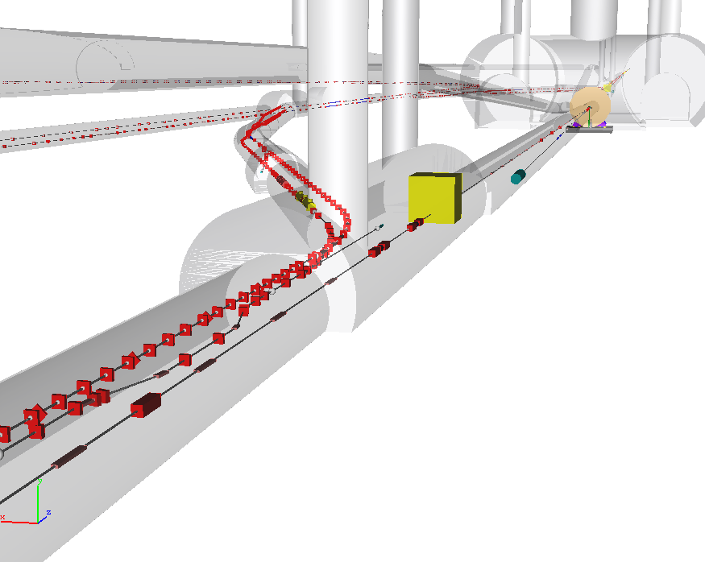
Central Region Integration
Damping Rings
detector
RTML return line
e+ main beam dump
e- BDS muon shield
e+ source
e- BDS
3D CAD has been used to developed beamline layouts and tunnel requirements.
Complete model of ILC available.

Slide 32
Where are we?
Requirements (from Physics and Detector)
Design evolution to the TDR baseline
Baseline 500 GeV E_{cm} Parameters
Approach to Site-Dependent Design Variants
ILC overview (intro to detail talks)
RTML and bunch compressor
Emittance preservation (beam dynamics)
Low E_{cm} Running
Luminosity upgrade
TeV energy upgrade

Slide 33
Emittance Preservation
Damping Ring: γε_{y} = 20nm
~30km RTML return line
Turn around and spin rotation
Bunch compressor (two-stages)
Acceleration (10km main linac)
Positron production (e- only)
Beam delivery system (non-linear optics)
Final Doublet and collision!
Budget 15 nm → γε_{y} = 35 nm at IP

Slide 34
Emittance Budgets
 | Mean | 90% level
Damping ring extraction | 20
RTML (Return line, turn-around, spin rotation) | +5.4 | 9.9
RTML (Bunch compressors) | +1.1 | 1.5
Main Linac | +4.5 | 8.8
End of Main Linac (total) | 31 | 37
BDS (budgeted) | +4
IP (effective): | 35 | >40
Results of extensive simulations
(over 10 years)
Standard alignment (survey) errors assumed
Several beam-based alignment techniques studied (most notably DFS)
‘Realistic’ simulation (including wakefields, non-linear fields etc.)
Tuning algorithms (dispersive closed bumps, final focus tuning etc.)
Dynamic errors included (ground motion, vibration, beam-based feedback etc.)
→ 35nm @ IP looks OK on average (in simulation!)

Slide 35
Low Ecm Running (<300 GeV)
Positron production (yield) drops with <150 GeV
Low E_{cm} running (≤250 GeV) → 10Hz mode
Alternate pulses for e+ production:
150 GeV e- pulse to generate positrons
E_{cm}/2 e- pulse for luminosity
Ramifications:
100ms store time in DR → shorter damping times
Need to dump 150 GeV production pulse after undulator (new beamline, pulsed-magnet system)
Pulsed trajectory-correction system before undulator for 150 GeV production beam.
Electron Main Linac requires no modification
Installed AC power sufficient for ~½ energy operation at 10Hz.

Slide 36
Luminosity Upgrade
Concept: increase n_{b} from 1312 → 2625
Reduce linac bunch spacing 554 ns → 336 ns
Increase pulse current 5.8 → 8.8 mA
Increase number of klystrons by ~50%
Doubles beam power → ×2 L (3.6×10³⁴cm⁻²s⁻¹)
Damping ring:
Electron ring doubles current (389mA → 778mA)
Positron ring: possible 2nd (stacked) ring (e-cloud limit)
AC power: 161 MW → 204 MW (est.)
AC power increased by ×1.5
shorter fill time and longer beam pulse results in higher RF-beam efficiency (44% → 61%)

Slide 37
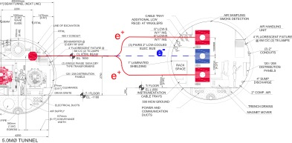
Luminosity Upgrade
Adding klystrons (and modulators)
KCS Building
Flat Topography (KCS)
MountainTopography (DKS)
Damping Ring:

Slide 38
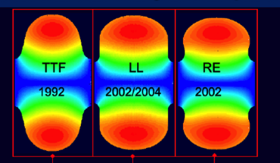
TeV Upgrade
<26 km ?
(site length <52 km ?)
1.1 km
<10.8 km ?
10.8 km
1.3 km
2.2 km
Main Linac
BDS
e+ src
IP
bunch comp.
Assume Higher Gradient
Main Linac
<G_{cavity}> = 31.5 MV/m
G_{eff} ≈ 22.7 MV/m
(fill fact. = 0.72)
central region
Snowmass 2005 baseline recommendation for TeV upgrade:
G_{cavity} = 36 MV/m ⇒ 9.6 km
(VT ≥ 40 MV/m)
Based on use of low-loss or re-entrant cavity shapes

Slide 39
TeV upgrade: Construction Scenario
500GeV operations
start civil construction
BC
Main Linac
BDS
e+ src
IP
civil construction + installation
500GeV operations
BC
Main Linac
BDS
e+ src
IP
Installation/upgrade shutdown
BC
Main Linac
BDS
e+ src
IP
final installation/connection
removal/relocation of BC
Removal of turnaround etc.
Installation of addition magnets etc.
Commissioning / operation at 1TeV
BC
Main Linac
BDS
e+ src
IP
Notes:
An obvious possible approach to minimizing downtime for physics.
Assume something like a total of 5 year construction with perhaps 12-18 months with no physics??

Slide 40
TeV Parameters (2 sets)
P_{AC} constrained ≤300 MW
shorter bunch length (within BC range)
horizontal focusing main difference
low and high beamstrahlung

Slide 41
Detailed Presentations
SCRF Tech: Cavities and Cryomodules | A. Yamamoto
afternoon:
Main linac layouts (incl. design variants) | M. Ross
RF power generation / distribution | S. Fukuda
Electron and positron sources | W. Gai
Damping Rings | G. Dugan
Beam delivery system and MDI | K. Buesser
CFS | V. Kuchler A. Enomoto

